Slide 1
ARM - Advanced RISC Machines
RISC- Reduce Instruction Set Computers

Slide 2
ARM Design Philosophy
ARM Core uses a RISC architecture
ARM licenses its cores out and other companies make processors based on its cores
ARM processor core based microcontrollers
Von Neumann architecture.

Slide 3
ARM Design Philosophy
Reduce power consumption
High code density
Price sensitive
Reduce the area of the die taken up by the embedded processor
Incorporated hardware debug technology (ICE)

Slide 4
ARM processor core based microcontrollers
Key component of many 32 –bit embedded systems and Portable Consumer devices
ARM1 prototype in 1985
One of the ARM’s most successful cores is the ARM7TDMI,provides high code density and low power consumption.

Slide 5
ARM7TDMI
T –Thumb 16 bit compressed instruction set
D – on chip Debug request
M – enhanced Multiplier(yields 64 bit result)
I – Embedded ICE hardware to give on-chip breakpoint and watchpoint support
ICE – in circuit emulator for debugging

Slide 6
The RISC Design Philosophy
RISC is characterized by limited number of instructions
A complex instruction is obtained as a sequence of simple instructions.
So, in RISC processor, software is complex but the processor architecture is simple.
Large number of registers are required.
Pipelined instruction execution.
Ex : ARM, ATMEL AVR, MIPS, Power PC etc

Slide 7
The CISC Design Philosophy
CISC is characterized by large instruction set.
The aim of designing CISC processors is to reduce software complexity by increasing the complexity of processor architecture.
Very small number of registers are available.
Ex : Intel X86 family, Motorola 68000 series.

Slide 8
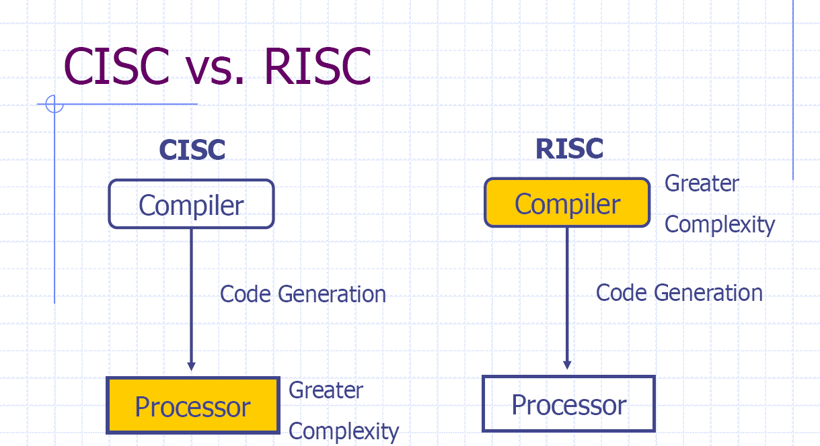

Slide 9
RISC –4 major design rules
Instructions
Reduced Number of Instructions
Execute in a single cycle
The compiler synthesizes complicated operations
Each instruction is a fixed length

Slide 10
2. Pipelines
The processing of instructions is broken down into smaller units that can be executed in parallel by pipelines
Pipeline advances by one step on each cycle for maximum throughput

Slide 11
3. Registers
Have a large general purpose register set
Any register can contain either data or address
CISC has dedicated registers for specific purposes.

Slide 12
4. Load –Store Architecture
Separate load and store instructions transfers data between the register bank and external memory.
Memory accesses are costly, so separating memory access from data processing provides an advantage, because you can use data items held in register banks multiple times without needing multiple memory accesses.

Slide 13
Load/Store Architecture
Memory accesses slow a processor down.
There are times when the processor is doing nothing, while waiting for memory accesses to complete.
So, we define a new architecture. In this new load/store architecture, the addressing mode for every operand is fixed. (So, there are no bytes for addressing mode information.)
And, for arithmetic/logical type instructions, the addressing mode for all operands will be register mode.
We make sure that there are enough registers, because everything ends up in registers.
To get stuff to/from memory and into/out of registers, we have explicit instructions that move data.
Load instructions read data from memory and copy it to a register. Store instructions write data from a register to memory.

Slide 14
Overview: Core Data Path
Data items are placed in register file
No data processing instructions directly manipulate data in memory
Instructions typically use two source registers and single result or destination register
A Barrel shifter on the data path can pre-process data before it enters ALU
Increment/Decrement logic can update register content for sequential access independent of ALU

Slide 15
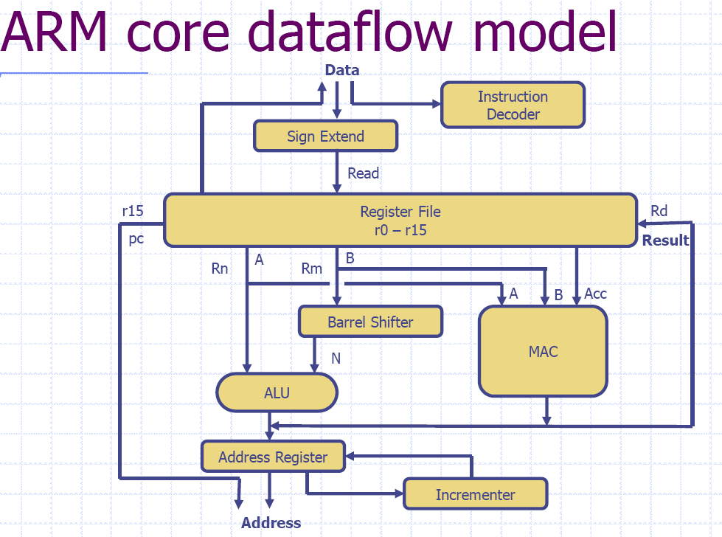
Multiply and Accumulate

Slide 16
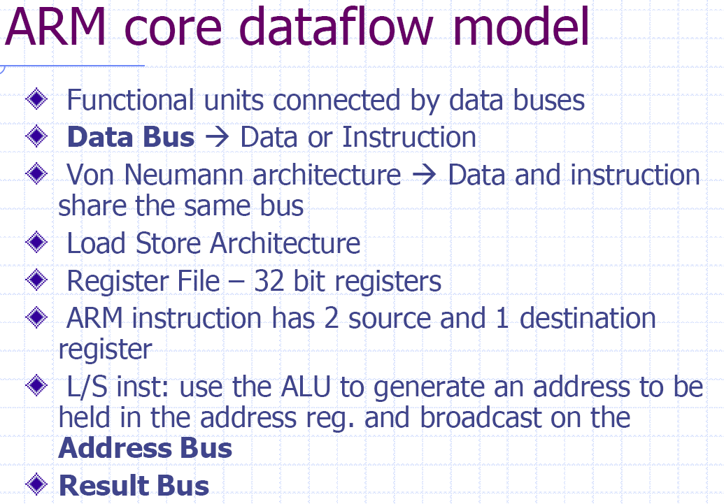

Slide 17
Registers
General purpose registers hold either data or address
All registers are of 32 bits
In user mode 16 data registers and 2 status registers are visible
Data registers: r0 to r15
Three registers r13, r14 and r15 perform special functions
r13: stack pointer
r14: link register (where return address is stored whenever a subroutine is called)
r15: program counter

Slide 18
Registers contd..
Depending upon context r13 and r14 can also be used as GPR
Any instruction which use r0 can as well be used with any other GPR(r1-r13)
In addition, there are two status registers
CPSR: Current Program Status Register
SPSR: Saved Program Status Register

Slide 19
Program Status Registers
31
28
27
24
23
16
15
8
7
6
5
4
0
N Z C V
U n d e f i n e d
I F T mode
f
s
x
c
Condition code flags
N = Negative result from ALU
Z = Zero result from ALU
C = ALU operation Carried out
V = ALU operation oVerflowed
Interrupt Disable bits.
I = 1: Disables the IRQ.
F = 1: Disables the FIQ.
T Bit
Architecture xT only
T = 0: Processor in ARM state
T = 1: Processor in Thumb state
Mode bits
Specify the processor mode

Slide 20
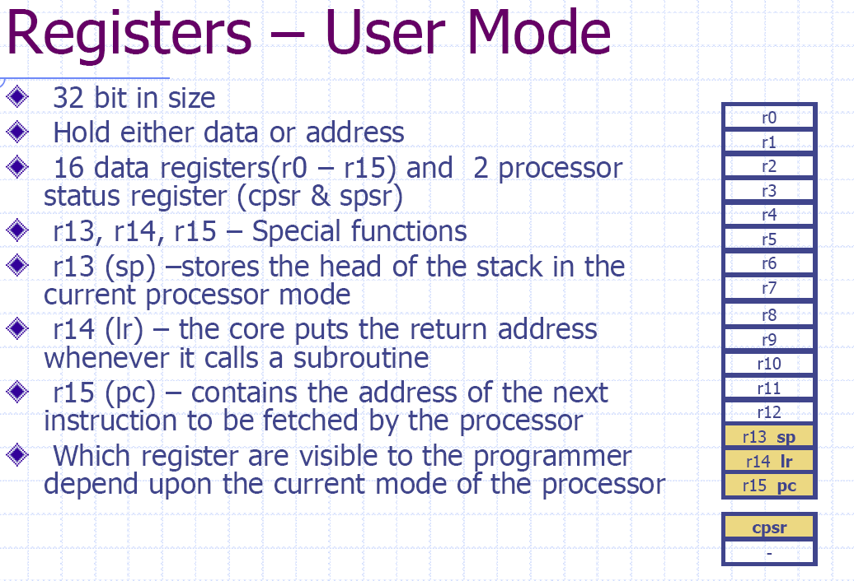

Slide 21
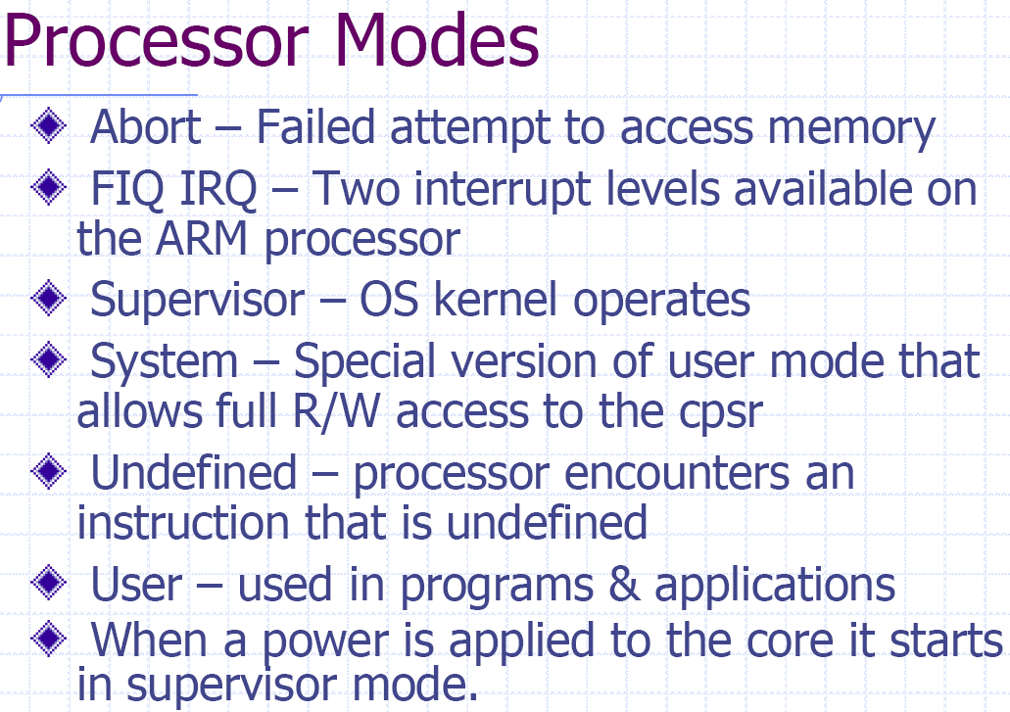

Slide 22
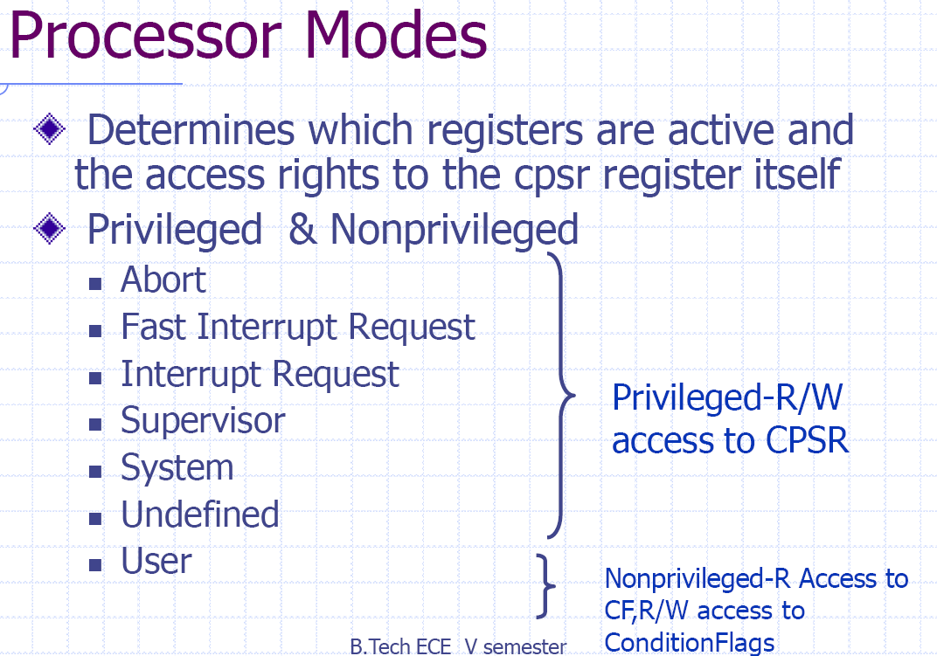

Slide 23
Processor modes
Processor modes determine
Which registers are active and
Access rights to CPSR register itself
Each processor mode is either
Privileged: full read-write access to the CPSR
Non-privileged: only read access to the control field of the CPSR but read-write access to the condition flags

Slide 24
Processor modes contd..
ARM has seven modes
Privileged: abort, fast interrupt request, interrupt request, supervisor, system and undefined
Non-privileged: user
User mode is used for program and applications

Slide 25
Privileged modes
Abort: when there is a failed attempt to access memory
Fast Interrupt Request (FIQ) & interrupt request: correspond to interrupt levels available on ARM
Supervisor mode: state after reset and generally the mode in which OS kernel executes

Slide 26
Privileged modes contd..
System mode: special version of user mode that allows full read-write access of CPSR
Undefined: When processor encounters an undefined instruction

Slide 27
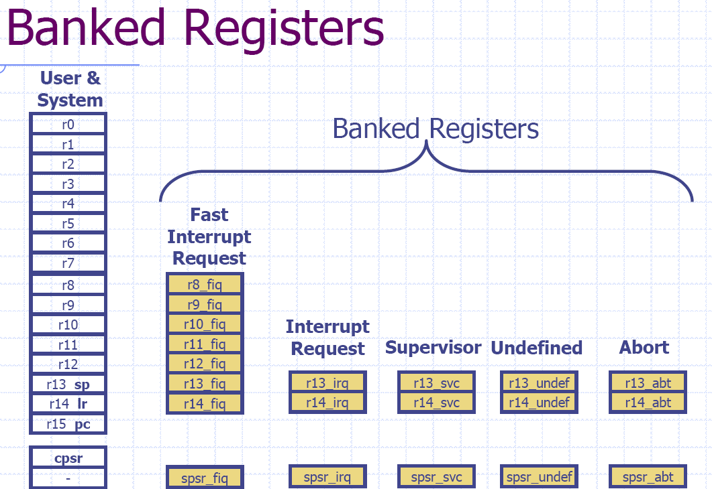

Slide 28
Banked Registers
Register file contains in all 37 registers
20 registers are hidden from program at different times. These registers are called banked registers
Banked registers are available only when the processor is in a particular mode
Processor modes (other than system mode) have a set of associated banked registers that are subset of 16 registers
Maps one-to-one onto a user mode register

Slide 29
Register Banking
Current Visible Registers
Current Visible Registers
User Registers replaced by
banked registers
User Mode
r0
User
r0
r1
r1
r2
r2
Banked out Registers
r3
Banked out Registers
r3
r4
r4
r5
r5
Abort
FIQ
IRQ
SVC
Undef
r6
FIQ
IRQ
SVC
Undef
Abort
r6
r7
r7
r8
r8
r8
r8
r9
r9
r9
r9
r10
r10
r10
r10
r11
r11
r11
r11
r12
r12
r12
r12
r13 (sp)
r13 (sp)
r13 (sp)
r13 (sp)
r13 (sp)
r13 (sp)
CPSR
copied
into
SPSR
r13 (sp)
r13 (sp)
r13 (sp)
r13 (sp)
r13 (sp)
r13 (sp)
r14 (lr)
r14 (lr)
r14 (lr)
r14 (lr)
r14 (lr)
r14 (lr)
r14 (lr)
r14 (lr)
r14 (lr)
r14 (lr)
r14 (lr)
r14 (lr)
r15 (pc)
r15 (pc)
cpsr
spsr
spsr
spsr
spsr
spsr
spsr
cpsr
spsr
spsr
spsr
spsr

Slide 30
SPSR
Each privileged mode (except system mode) has associated with it a SPSR (Stored Program Status Register)
This SPSR is used to save the state of CPSR (Current Program Status Register) when the privileged mode is entered in order that the user state can be fully restored when the user process is resumed

Slide 31
Mode changing
Mode changes by writing directly to CPSR or by hardware when the processor responds to exception (any condition that needs to halt the normal sequential execution of instructions) or interrupt
To return to user mode a special return instruction is used that instructs the core to restore the original CPSR and banked registers

Slide 32
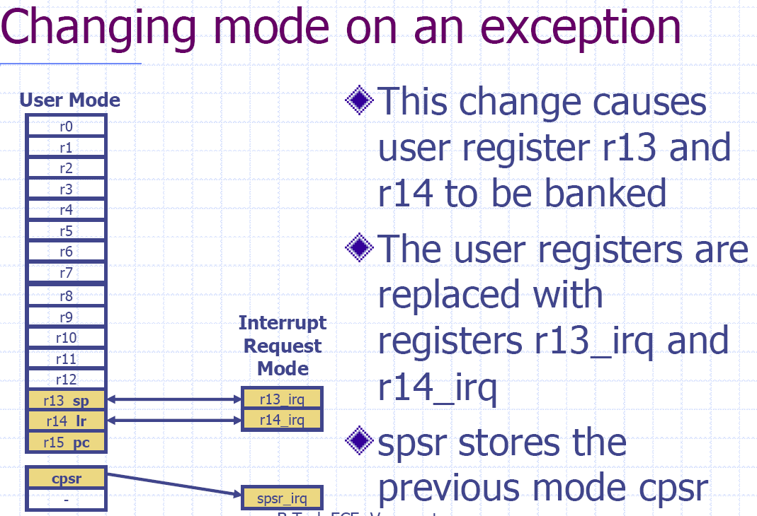

Slide 33
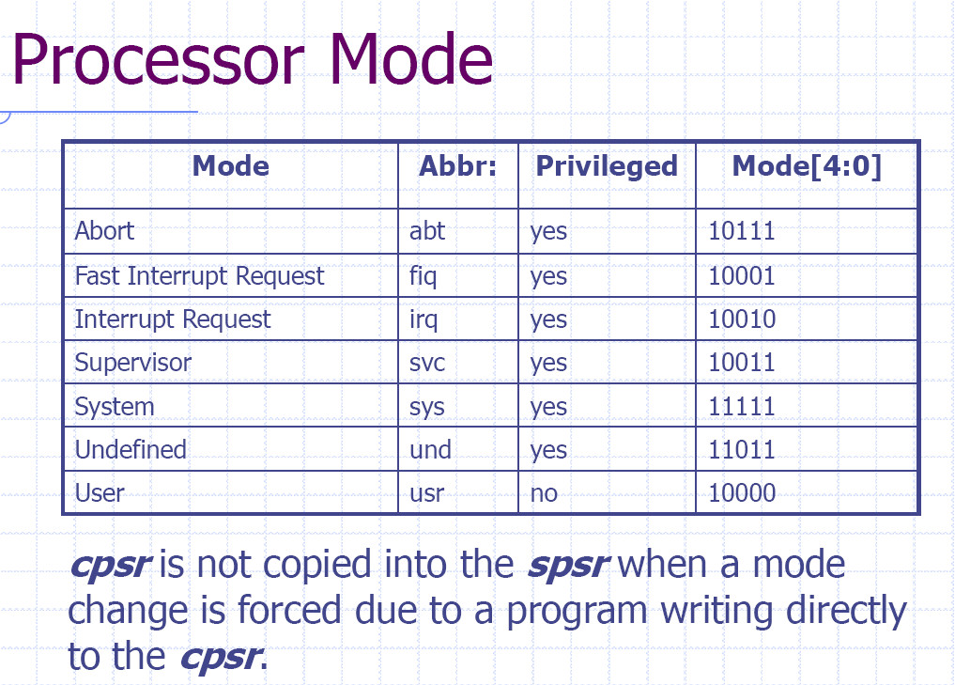

Slide 34
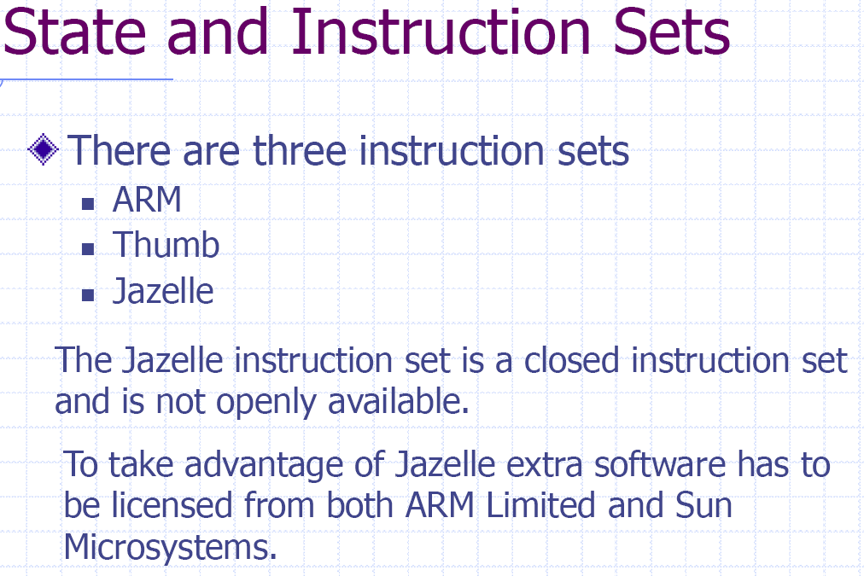

Slide 35
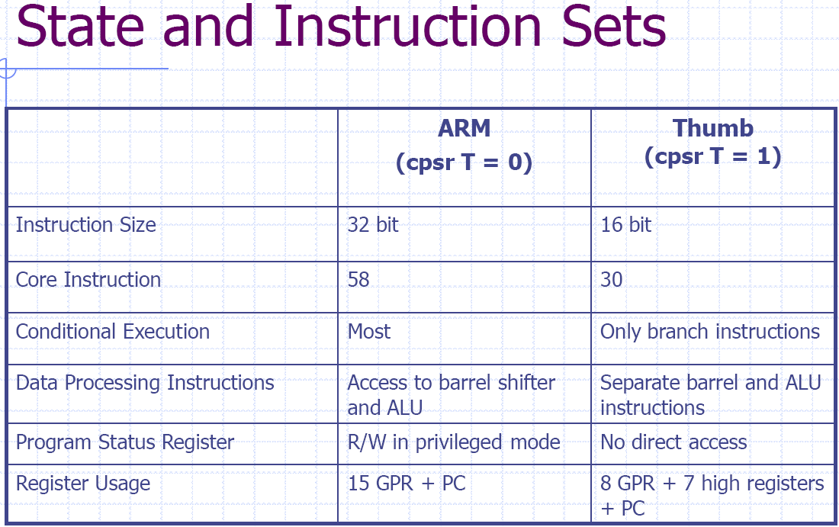

Slide 36
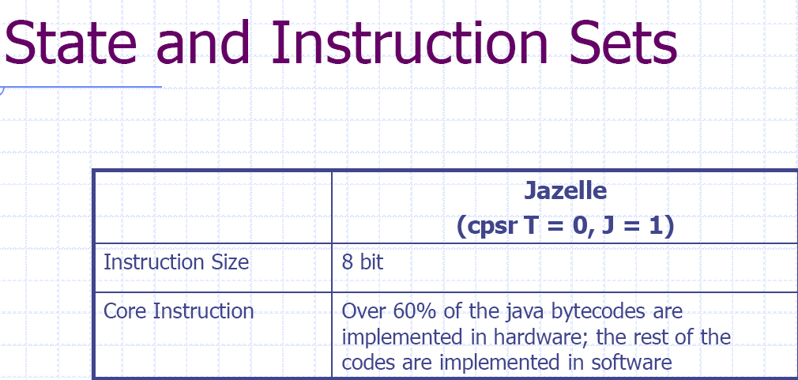

Slide 37
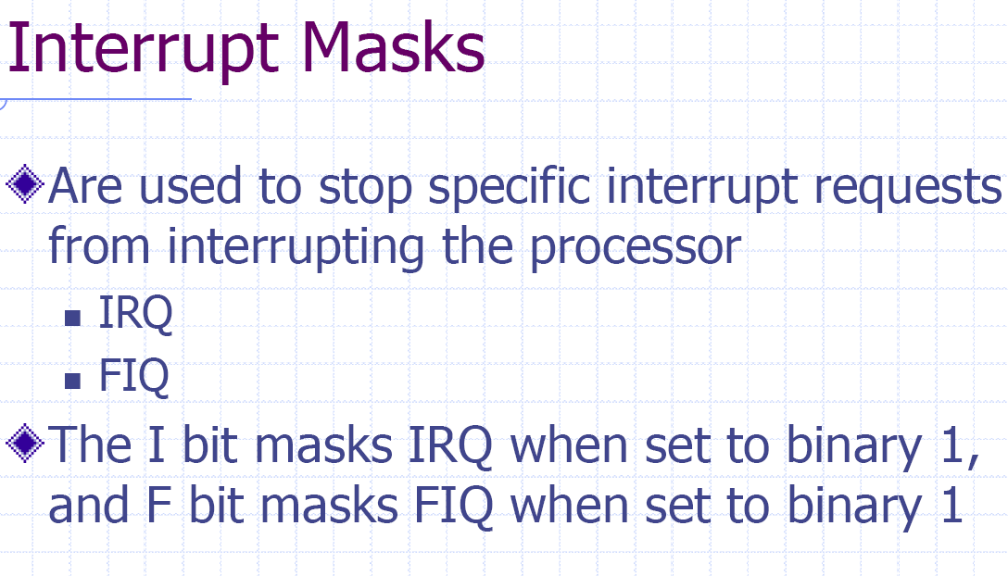

Slide 38
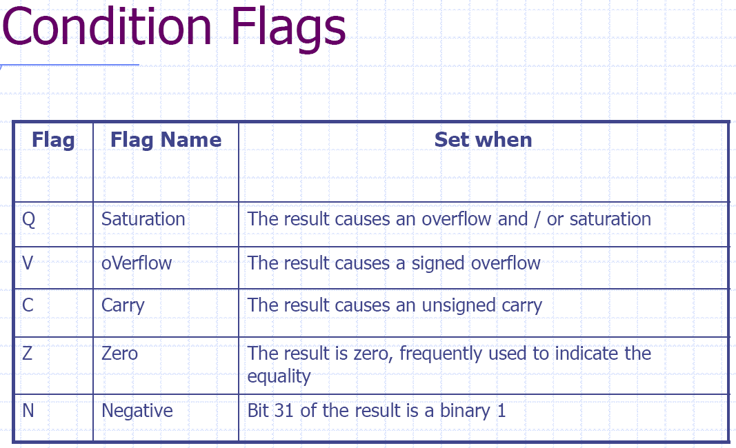

Slide 39
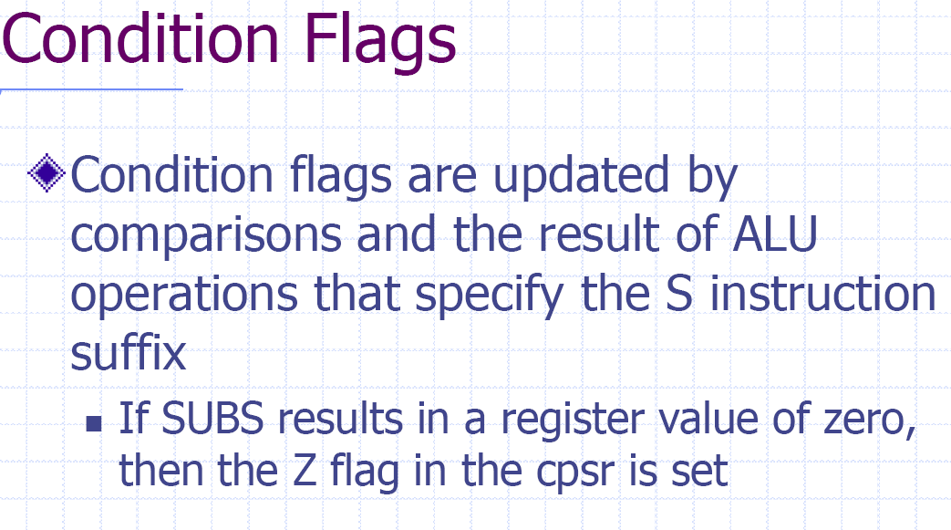

Slide 40
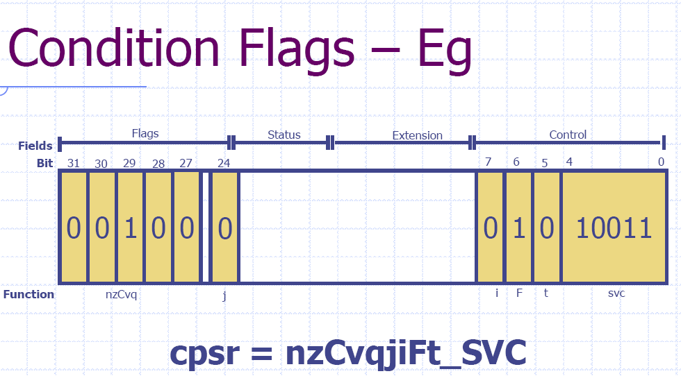

Slide 41
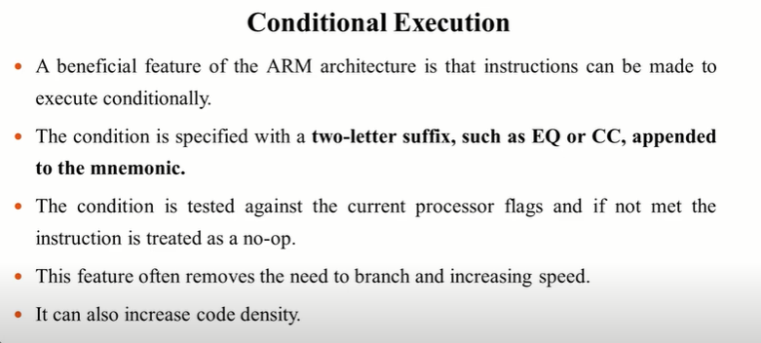

Slide 42
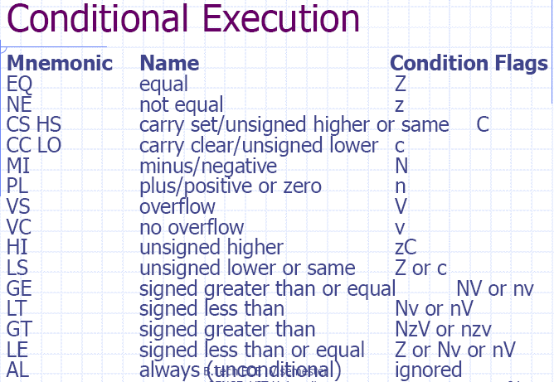

Slide 43
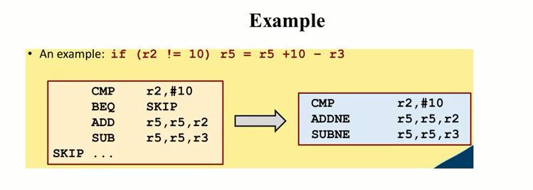

Slide 44
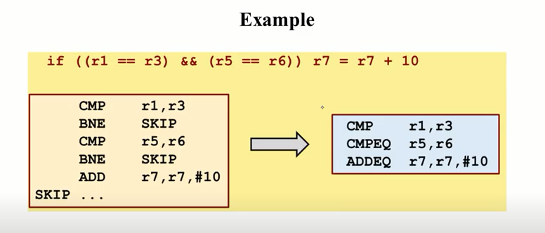

Slide 45
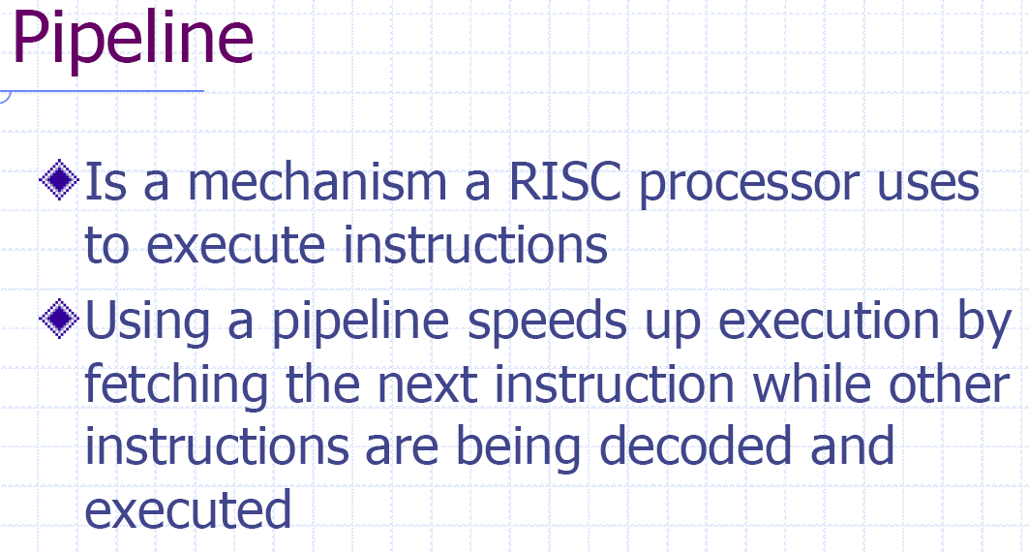

Slide 46
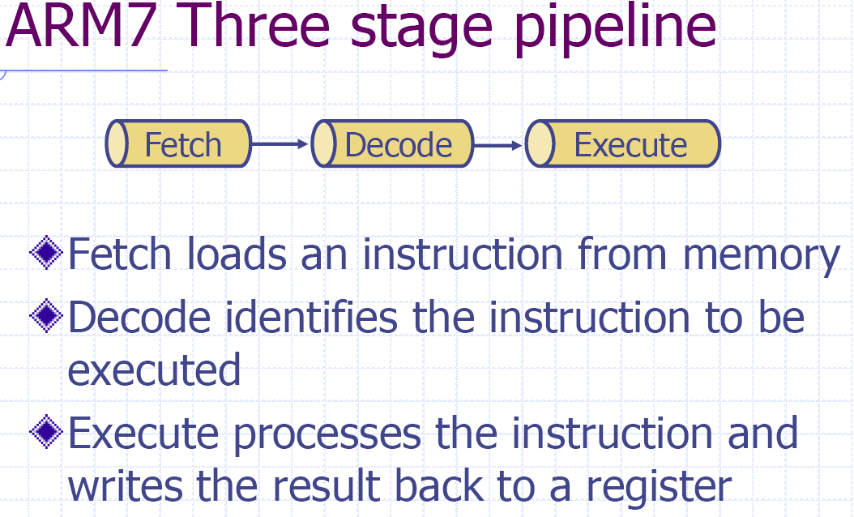

Slide 47
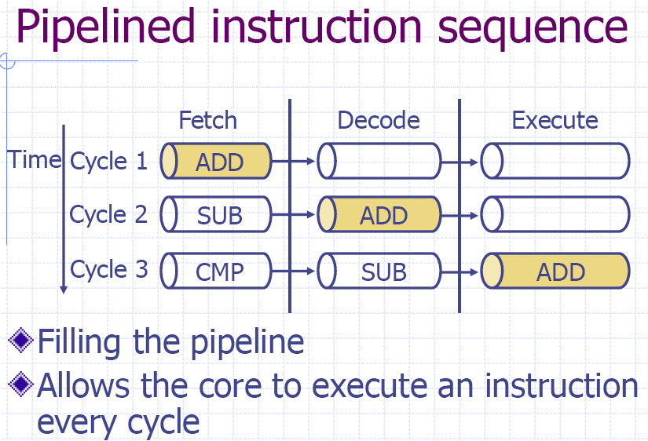

Slide 48
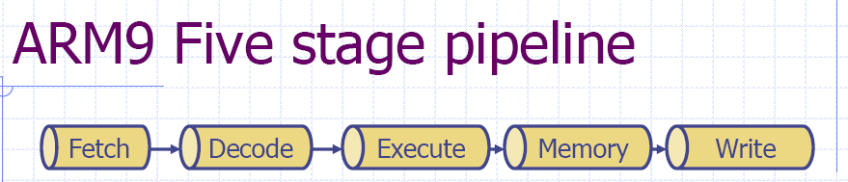
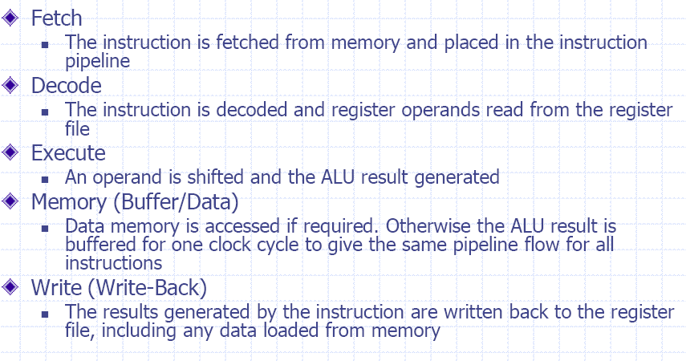

Slide 49
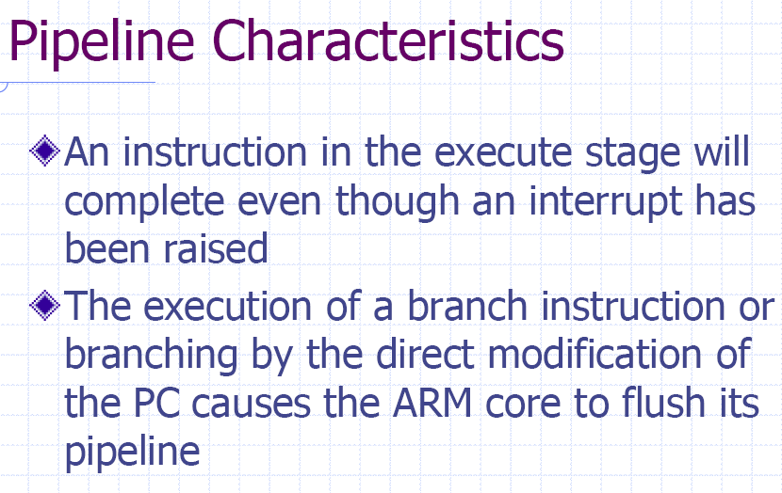

Slide 50
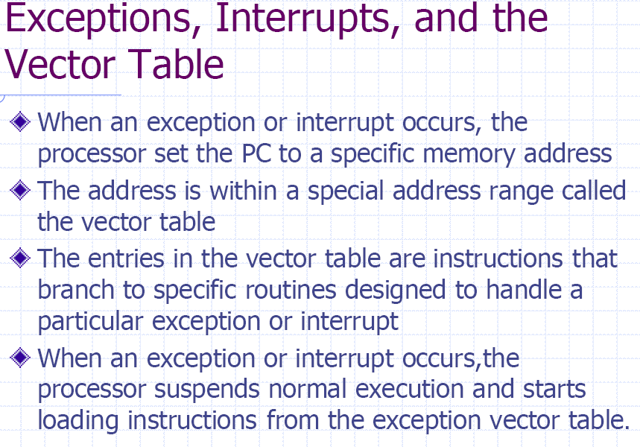

Slide 51
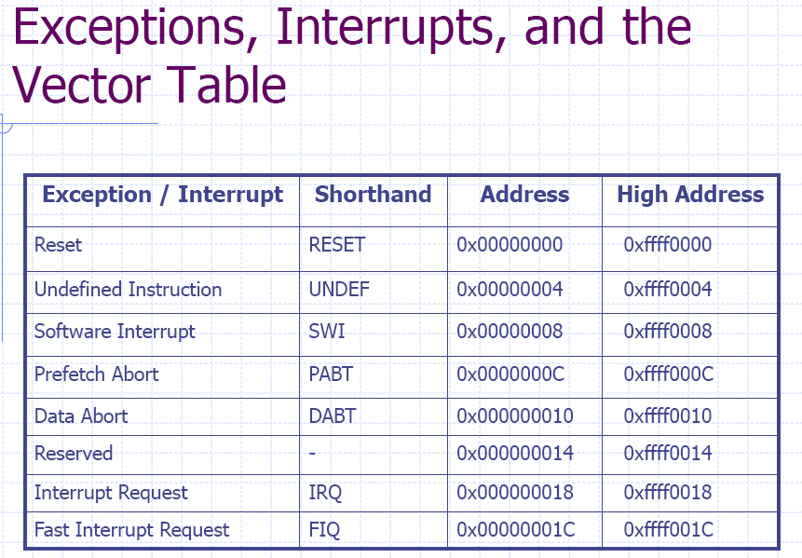

Slide 52
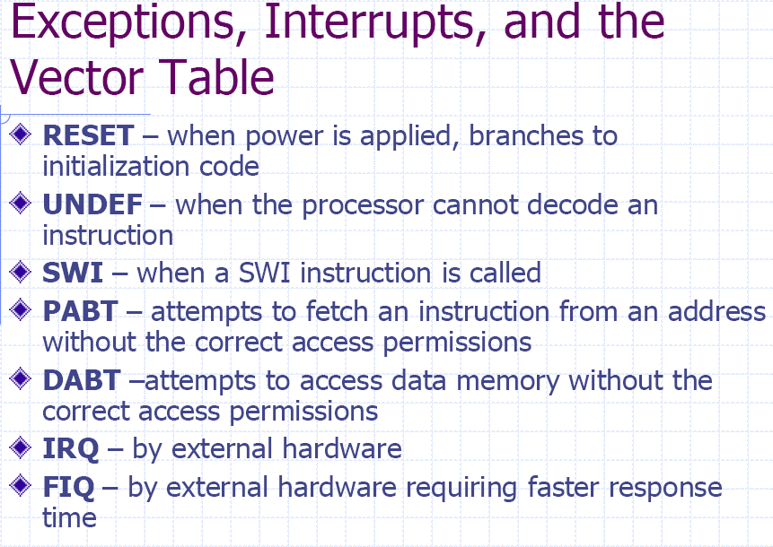

Slide 53
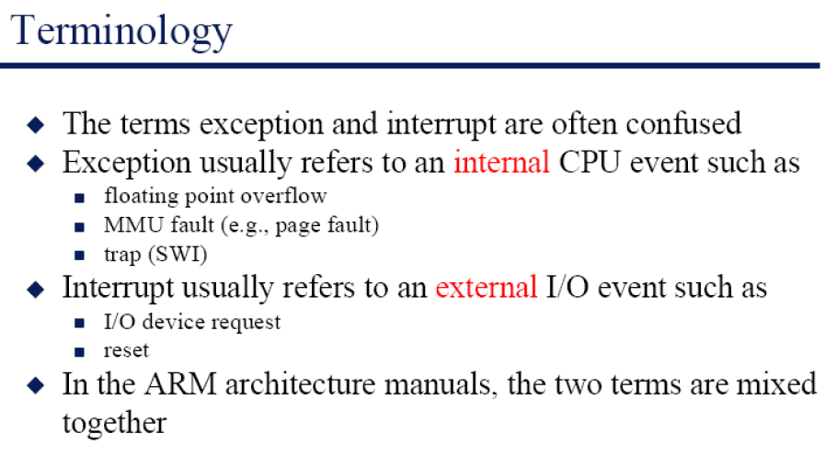

Slide 54
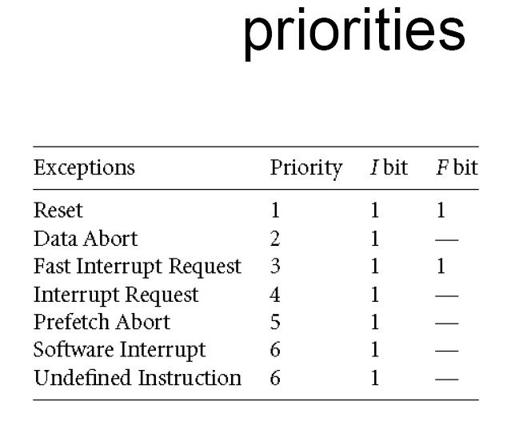

Slide 55
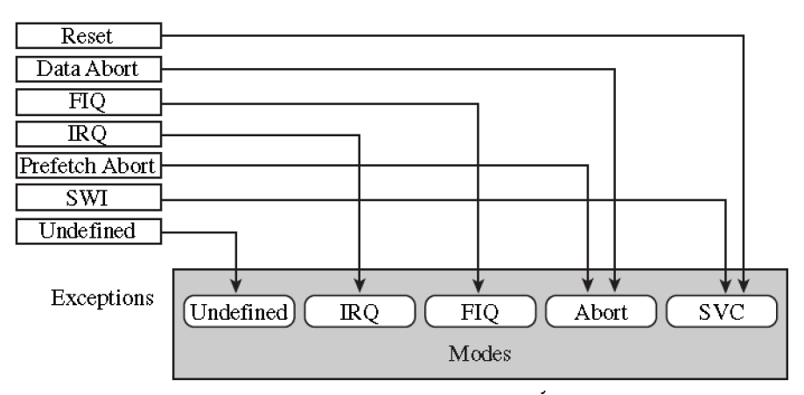

Slide 56


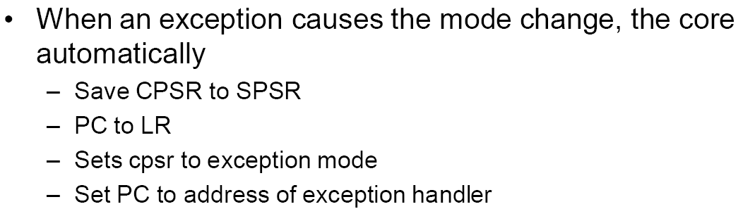

Slide 57
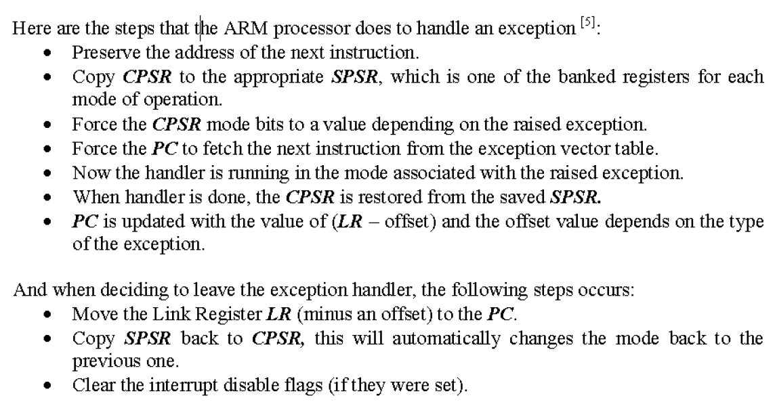

Slide 58
ARM Memory organisation
Can be configured as little endian or big endian
Little endian
Big endian

Slide 59
Memory organization contd..
"Little Endian" means that the low-order byte of the number is stored in memory at the lowest address, and the high-order byte at the highest address. (The little end comes first.) For example, a 4 byte Long Int Byte3 Byte2 Byte1 Byte0 will be arranged in memory as follows:
Base Address+0 Byte0
Base Address+1 Byte1
Base Address+2 Byte2
Base Address+3 Byte3
Intel processors (those used in PC's) use "Little Endian" byte order.

Slide 60
Memory Organization contd..
"Big Endian" means that the high-order byte of the number is stored in memory at the lowest address, and the low-order byte at the highest address. (The big end comes first.) Our Long Int, would then be stored as:
Base Address+0 Byte3
Base Address+1 Byte2
Base Address+2 Byte1
Base Address+3 Byte0
Motorola processors (those used in Mac's) use "Big Endian" byte order.

